Slide 1
Research on Random Forest Algorithm
Lingnan University School of Data Science
2024/11/19
Multi-Class Prediction of Obesity Risk
————Research on Random Forest Algorithm
Suhai LUO, Yuqi GUAN, Xinyu DONG, Xinghua HUANG, Bowen TANG, Linling SHEN

Slide 2
CONTENTS
Background Introduction
Data collection and description
Data cleaning and preprocessing
Method applying
Model Training and Result Interpretation
Model comparison
Conclusion

Slide 3
1
Background Introduction

Slide 4

Background Introduction
Background
Obesity leads to social stigma and discrimination, harming mental health and quality of life, causing shame, low self-esteem, and depression. Health-wise, it's a major risk for chronic diseases like heart disease, diabetes, hypertension, cancers, and respiratory issues.
It's a leading cause of preventable mortality, emphasizing the need to focus on obesity and its causes.The risks associated with obesity are vast and multifaceted.Obesity is one of the leading causes of preventable mortality,with higher risks of heart disease, stroke, and diabetes [3].Those are the substantial evidences for us to focusing on obesity and its causes.

Slide 5
2
Data collection and description

Slide 6

Data collection and description
Regarding Predicting Obesity Risk
The current challenge focuses on predicting obesity risk,a complex problem that involves understanding how variousfeatures correlate with health outcomes. This setup allows data miners to practice identifying the most relevant features,managing imbalanced data, and deploying techniques to avoid over fitting all critical skills in data mining.
Skills
managing imbalanced data
deploying techniques
avoid over fitting

Slide 7



Data collection and description
Mexico
Peru
Colombia
Mexico
Peru
Colombia
The data consist of the estimation of obesity levels in people from the countries of Mexico, Peru and Colombia, with ages between 14 and 61 and diverse eating habits and physical condition , data was collected using a web platform with a survey where anonymous users answered each question, then the information was processed obtaining 17 attributes and 2111 records [4]. The synthetic nature of the dataset also ensures that participants can freely experiment without concerns over data privacy or ethical constraints, making it an ideal sandbox for testing new ideas and algorithms.

Slide 8
Data collection and description
Data Analysis
Data is available in CSV format. The attributes obtained Gender, Age, Height, Weight, family history with overweight,MTRANS, and Physical Health Indicators. The data containsboth numerical data and continuous data, which can be used for analysis based on algorithms of classification, prediction,segmentation and association.
Age
Hight
Weight
Gender

Slide 9

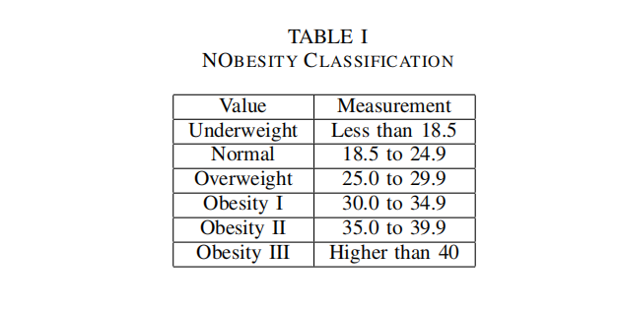
Data collection and description
The variable to be predict is ‘NObesity’ and its values are shown in Table I below
The Physical Health Indicators are specified: Frequent con sumption of high caloric food (FAVC), Frequency of consump tion of vegetables (FCVC), Number of main meals (NCP),Consumption of food between meals (CAEC), Consumption of water daily (CH20), and Consumption of alcohol (CALC).The attributes related with the physical condition are: Calories consumption monitoring (SCC), Physical activity frequency (FAF), Time using technology devices (TUE), Transportation used (MTRANS) [5].

Slide 10
3
Data cleaning and preprocessing

Slide 11
Data cleaning and preprocessing
Step 4
Align train and test Sets
Step 2
Handle Outliers & Missing Values
Training sets and testing sets might have different values so we need to ensure that both train and test datasets have thesame features eventually, especially after encoding categorical features.
﻿
If there are many outliers or missing values, consider fulfilling
or dropping the column. Remove attributes if they are irrelative
to prediction.
Use info(), describe(), head() to check for column data types
and null values and understand the numerical data distribution.
Perhaps the attributes are related so that we can combine several of them to derive a new variable. Typically we can assemble the year, month, and day into a date time column.
Ensure that categorical features are of type category or object
then convert them into numeric for further modeling.
Step 1
Initial Data Exploration
Step 3
Data Type Conversion
Step 5
Feature Alignment and Engineering
we do the followings to preprocessing data in order to meet the prerequisite of model training.Steps by steps, We import the necessary libraries pandas, sklearn. Then load both train.csv, test.csv files into pandas Data Frames:

Slide 12
4
Method applying

Slide 13
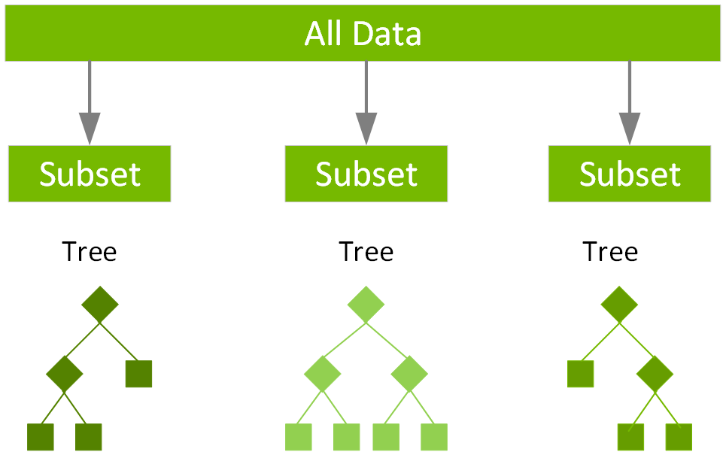
Method applying
Random forest
Random forest is a suitable choice for these two datasets due to several key advantages that it offers, especially for tabular data with both numeric and categorical features.The inherit features of random forest include robustness to over fitting and feature importance. Random forest, as an ensemble learning method, combines multiple decision trees built on different subsets of the data. This reduces the risk of over fitting, making it more generalizable to unseen data compared to a single decision tree. It also provides feature importance scores, which can help in understanding which features contribute the most to predictions. This is useful for interpreting model results and refining feature engineering [6].

Slide 14
5
Model Training and Result Interpretation

Slide 15
Model Training and Result Interpretation
Initialize the Random Forest Model
To apply random forest in our study, we can do the following process assuming that data preprocessing is already completed and Load the Preprocessed Data
Separate Features and Target Variable
Define the target variable (y) and feature set (X) from the training data. Ensure the test data has the same features.
Step 1
Split the Training Set Additional validation is needed within the training set.
﻿
Step 2
Initialize the Random Forest Model
Choose RandomForestClassifier for classification tasks or Ran domForestRegressor for regression tasks..
Step 3
Make Predictions
Step 4
Fit the model on the training set and then predict on the validation or test set.
Evaluate the Model
Step 5
Calculate accuracy score to evaluate random forest effect.The result predicts the possible obesity type of each person according to their basic conditions. ‘Weight’ is the most relative attribute to obesity levels. ‘Obesity Type III’ occupies the most while others obtains separately.

Slide 16
6
Model comparison

Slide 17
Model comparison
Model comparison
RanRandom Forests, Decision Trees, and Neural Networks are popular machine learning models used for various predictive tasks. Each has its unique strengths and weaknesses, making them suitable for different types of problems and datasets.
﻿
Decision Trees are simple, intuitive models that split data into branches to make predictions based on feature values. They create a tree-like structure where each internal node represents a test on an attribute, each branch represents an outcome, and each leaf node represents a class label or regression value.
Random Forests are an ensemble learning method that builds multiple decision trees using random subsets of data and features. The final prediction is made by aggregating the predictions of all individual trees.
Neural Networks are computational models inspired by the human brain’s neural networks. They consist of layers of interconnected nodes (neurons) that can learn complex patterns through training on large amounts of data [7].
We chose random forest on this task because of its balance of accuracy and over fitting control with lower computationalcost.

Slide 18
7
Conclusion

Slide 19
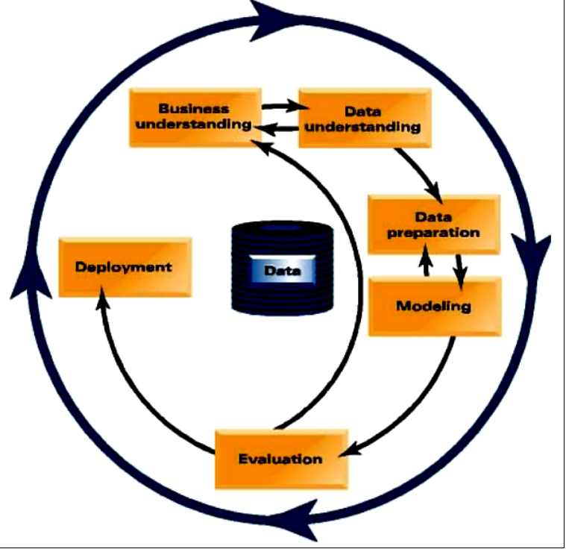
Conclusion
Conclusion
As Fig. 1 mentioned for this training task, we focused on building a predictive model using the random forest algorithm on two datasets going through all steps led by data mining process. The prediction accuracy reached 0.8839.

Slide 20
2024
THANK
YOU
Lingnan University School of Data Science

